Slide 1

Predicting Loan Interest Rate using different Regression Models
By Ali Zamin

Slide 2
CONTENTS
Introduction
Abstract
Dataset Information
Data Preprocessing
Data Visualization
Procedure and Tools
Modelling Techniques
Result
Conclusion

Slide 3
Introduction
As you may know, interest rate is an important part of the loan.
The lowest the interest rate, the better.
The interest rate depends on many factors, such as, household income, fico score, loan duration, bank etc.

Slide 4
Abstract
The motive of this project is to build several regression models to predict the amount of interest rate a person can get based on certain factors and evaluate the models’ prediction result.
The evaluation of the models will be done using Mean Squared Error.
The loan data was retrieved from an AWS RDS (Amazon’s Cloud relational database).

Slide 5
Dataset Information
There are two datasets that were used. One dataset for loan applicant and the other dataset for loan details.
The two datasets were merged together using the primary keys.
The loan applicant dataset has about 1,119,293 observation
The loan details dataset has about 421,386 observations.
After joining the two datasets, the resulting dataset has 1115927 rows.

Slide 6
There are about 17 variables in the resulting dataset.
Variables include: applicant_name, application_date, is_business, is_public, fico_score, credit_rating, loan_type, max_approved_amn, is_married, gender, household_income, borrow_amt, loan_duration, is_fixed_rate, issuing_bank, approved, interest_rate

Slide 7
Data Pre-processing
First, removed all the missing values in the interest_rate column.
The dataset contains data about both personal and business loans. However, there was no data for fico_score and household_income for business loan (which is expected for a business loan). So, as a result, I focused on only personal loans and filtered out business loans.
The columns is_public and credit_rating had all NA values, so I decided to drop them.
I also removed applicant_name and application_date columns. Applicant name column had a sequence of characters and don't have much predictive power.

Slide 8
Data Pre-processing
There were some categorical columns in the datasets, like loan_type, gender, Issuing_bank, that needed to be changed to numerical columns.
I converted each categorical values into dummy variables.
Normalized data using standard scaling method.

Slide 9
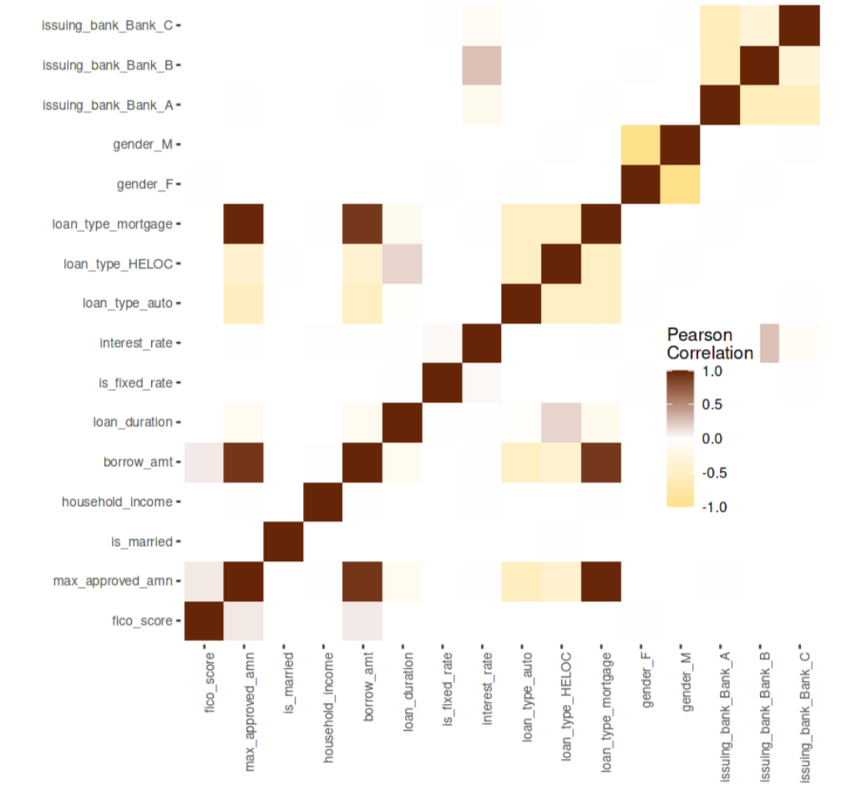
Data Visualiaztion

Slide 10
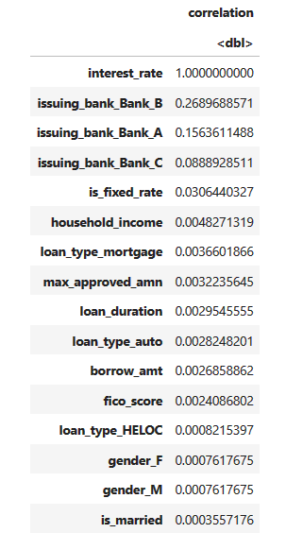
Data Visualization

Slide 11
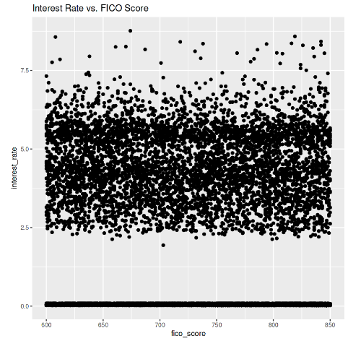
Data Visualization

Slide 12
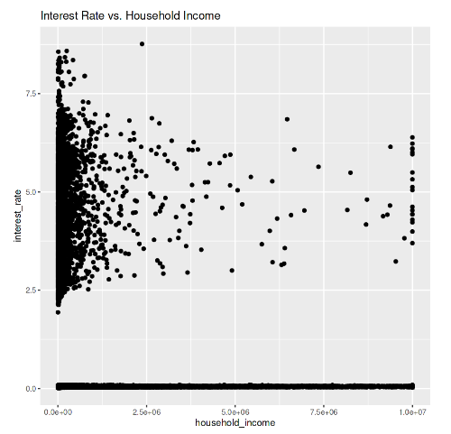
Data Visualization

Slide 13
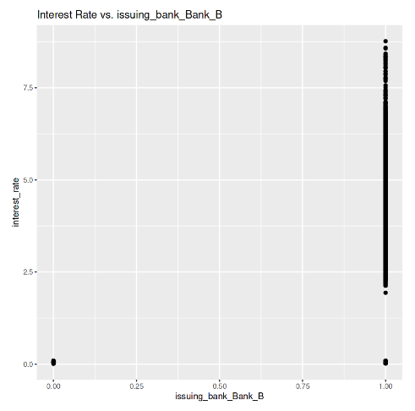
Data Visualization

Slide 14
Tools
Kaggle Notebook
RMySQL, Tydyverse, caTools, glmnet, rpart, e1071, nnet

Slide 15
Modelling Techniques
I used 4 algorithm for the data modelling.
1. Lasso regression
2. Ridge regression
3. Decision Tree
4. Neural Network

Slide 16
Procedure
Selecting Features and target variable.
Splitting data for training and testing. 90% training and 10% testing.
Cross validation.

Slide 17
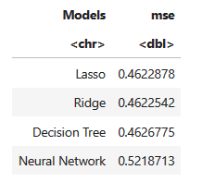
Result

Slide 18
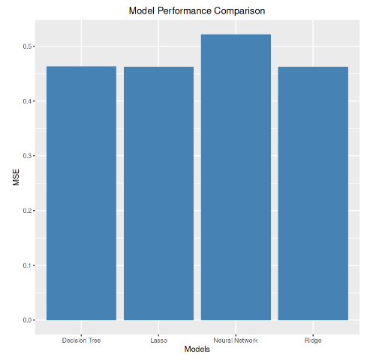
Result

Slide 19
Conclusion
The result shows that Lasso Regression performed better than the other model. However, Ridge Regression and Decision Tree also had pretty similar results.
The only significant difference in result was for Neural Network.
An interesting fact I found was that the most important feature that has the highest predictive power is the bank where the loan was taken. So, the interest rate that you could get for a loan will highly depend on the bank.

Slide 20
Reflection
More Statistics
The type of loan
Fraud detection
Loan Approval

Slide 21
Project Kaggle Notebook (Code)
https://www.kaggle.com/code/alizaminali/statistical-learning-2-project/notebook

Slide 22
THANK YOU

